Slide 1
SOEN 6441- WARZONE RISK GAME PROJECT BUILD 1
TEAM U14
Devansh akruvala
Meshva patel
Smridhi verma
Aditya gupta
KaranDeep saini
Gowtham nalluri

Slide 2
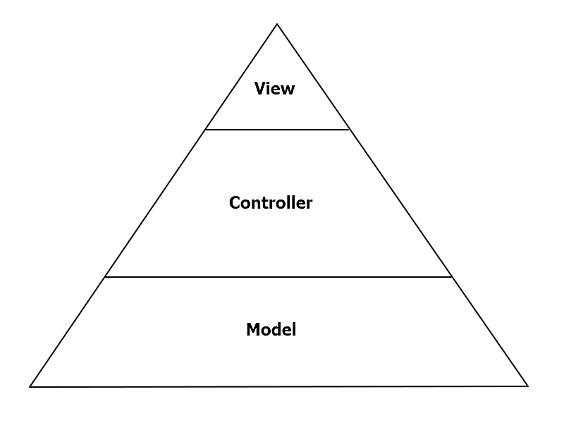

Mvc Architecture
Simultaneous development
High cohesion of similar phases
Ease of Modification and producing scalable S/W.

Slide 3
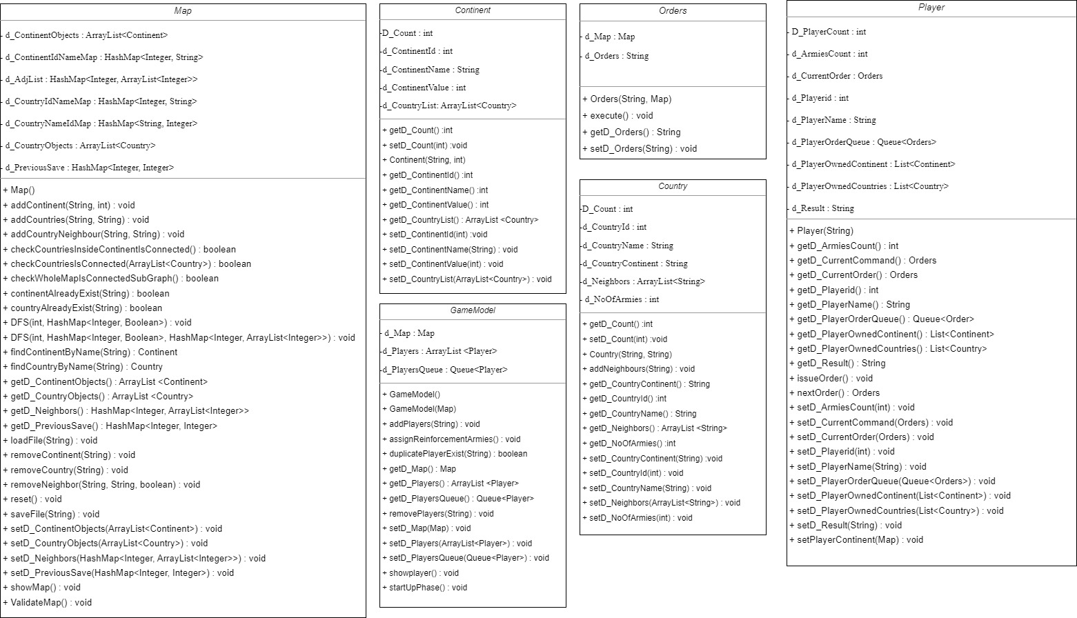
Model architecture

Slide 4
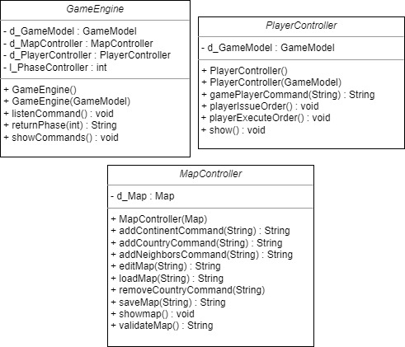
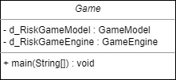
controller architecture

